Slide 1
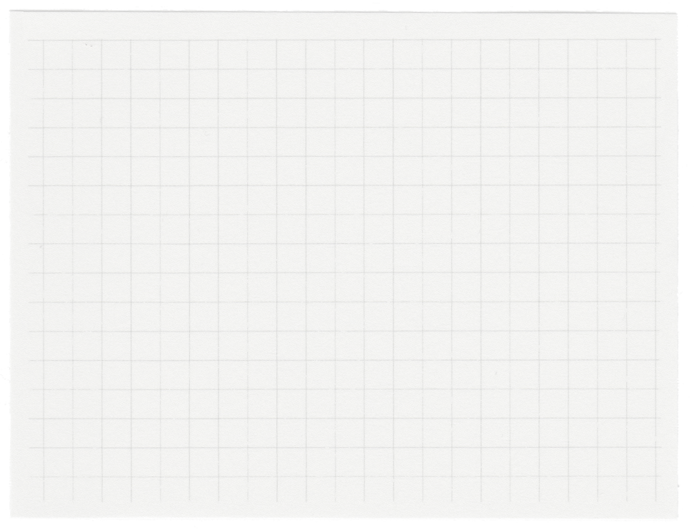













Medicube
Project presentation
Presented by Charumathi and team

Slide 2

Origin of the creative idea
1. Environmental Impact: Waste, especially plastic and electronic waste, poses a significant threat to the environment. It can pollute land, air, and water, leading to ecological degradation, harming wildlife, and contributing to climate change.
2. Resource Depletion: The production of waste often signifies inefficient use of resources. As natural resources become scarcer, the high rate of waste generation exacerbates the pressure on these resources, leading to increased costs and environmental strain.
3. Health Risks: Inadequate waste management can lead to serious public health risks. Exposure to toxic chemicals from waste, unsanitary conditions, and contaminated water sources can cause illness and spread diseases among humans and animals.
4. Economic Costs: Waste management and disposal are costly. As waste generation increases, governments and businesses face higher expenses for collection, treatment, and disposal, leading to economic strain and shifting financial burdens onto taxpayers and consumers.
waste is a significant and growing source of tension globally, with wide-ranging impacts on the environment, health, economy, and social structures.

Slide 3
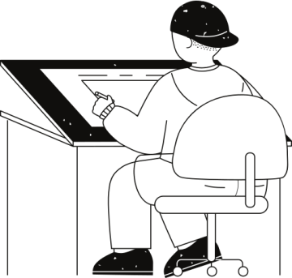




Amount of Pharmaceutical Waste Generated in India:
India generates significant amounts of pharmaceutical waste due to its large pharmaceutical industry. According to a report by the Times of India, in one year, India generated 56,000 tonnes of bio-medical waste​ (stopAMR)​.
Pharmaceutical Waste in Household Wastewater:
In India, household wastewater treatment is inadequate, with only about a fifth of the sewage generated in bigger cities and towns being treated. Pharmaceutical contaminants are often not removed by sewage treatment plants, leading to their presence in waterways and affecting wildlife and potentially human health​ (Mongabay-India)​.
STATISITC
Exploring Ideas
Environmental Impact of Pharmaceutical Waste:
The improper disposal of pharmaceutical waste contributes to the contamination of waterways and poses risks to wildlife and human health. Pharmaceutical pollutants, including antibiotic residues, can be found in river water, groundwater, and soil​ (Mongabay-India)​.
Illegal Dumping of Pharmaceutical Waste from Hospitals in India:
Cases of illegal dumping of pharmaceutical waste from hospitals are known, but specific statistics on these incidents are harder to find. Nonetheless, pharmaceutical pollution is a known issue, with inadequate treatment facilities and a lack of enforcement contributing to the problem​ (stopAMR)​.
.
.

Slide 4
Medicube
features
01
02
03
INTRODUCTION OF QR SYSTEM IN ALL MEDICAL PRODUCTION FOR UNIQUE ID
A WEB APPLICATION TO MAKE THE MOTTO EASY.
SCANNING OF ANY QR CODE WILL GIVE THE MEDICINE DETAILS LIKE :
DATE OF MANUFACTURING
DATE OF EXPIRY
USAGE AND DOSAGE
NOTIFYING THE USERS WHEN MEDICINE EXPIRES THROUGH GMAIL AND WEBSITE NOTIFICATION.

Slide 5
Medicube
features
04
05
06
MEDICINE TRACKING SYSTEM TO PREVENT ILLEGAL DUMPING OF WASTE
FAMILY MEDICINE HISTORY
USING ML TO SCAN ANY PRESCRIPTION AND GIVE INSIGHTS FROM FAMILY HISTORY

Slide 6

IMPLEMENTATION AND TECH STACK
Front-End : HTML, CSS, JavaScript, AJAX
Back- End : PHP
Database : My SQL
API Communication : AJAX
QR Code Generation and Scanning : Zxing Library
Alerts and Notifications : Send automatic alerts when a saved medicine expires or when the users make a reminder note on daily or weekly usage of medicine.

Slide 7
Optical Character Recognition (OCR) for Prescription Forms
To convert prescription forms into text format, we are using Optical Character Recognition (OCR) technology. OCR tools like Tesseract are popular for extracting text from images or scanned documents. we will be setting up an OCR engine and training it to recognize typical prescription form formats.
Family History Database Integration
This part requires a database that tracks the family's medication history, including current stock, past prescriptions, and consumption rates.
Stock Check and Calculation:
Calculate current medication stock based on the family history database.
Determine consumption rates by analyzing the consumption history. This can help predict how much medication is used within a certain period.
Check for expiration dates to ensure that expired medication is not counted toward current stock.

Slide 8
Output Generation:
Based on the above calculations, generate an output indicating whether the prescribed medication is already at home.
Include information on whether additional purchases are needed and any medications that might be approaching their expiration dates.

Slide 9
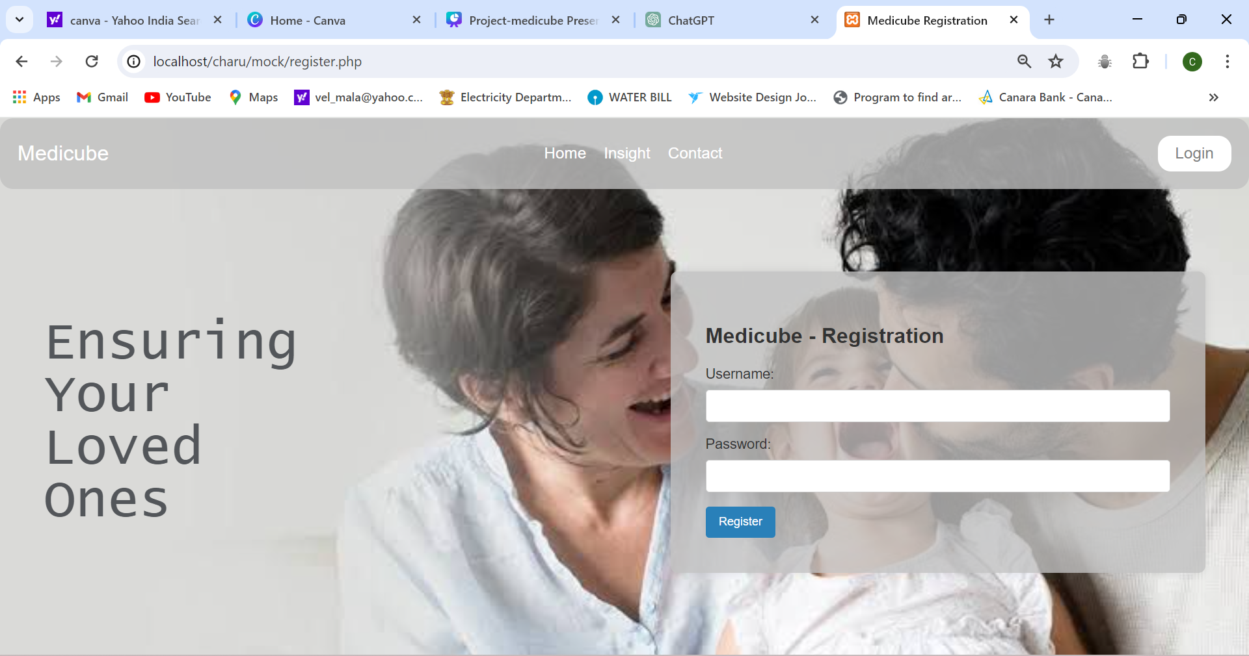
Ideation process

Slide 10
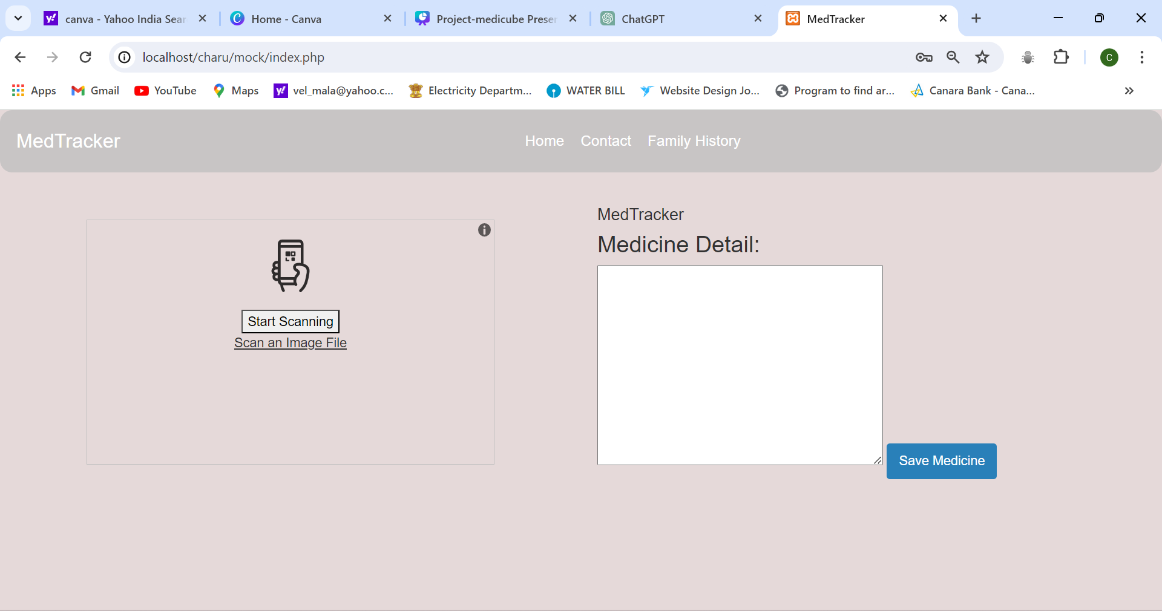

Slide 11
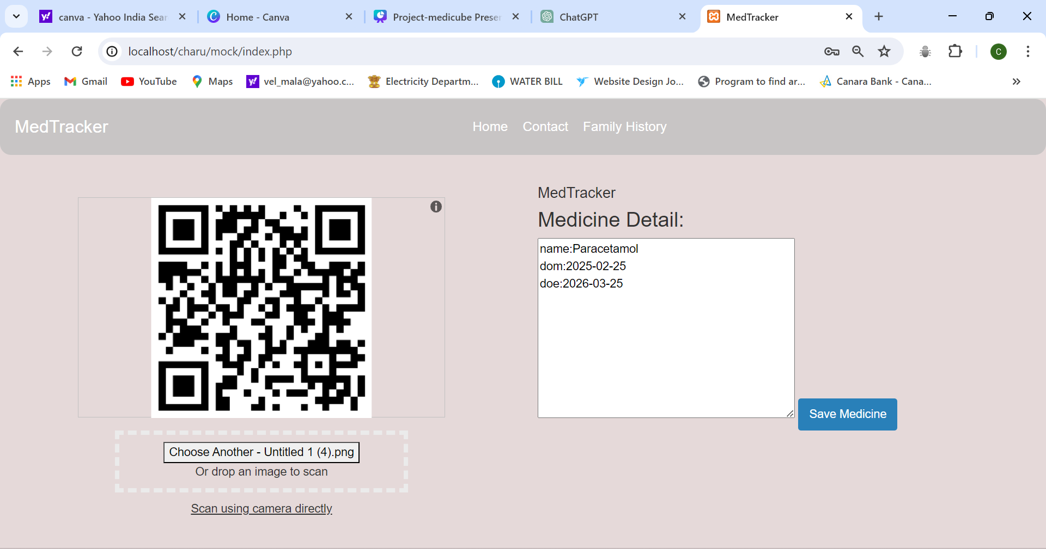

Slide 12
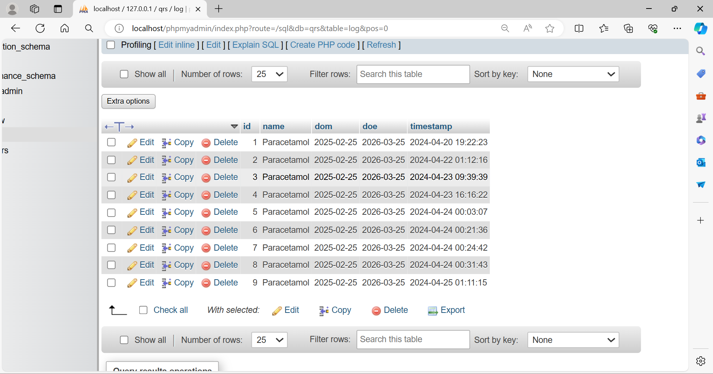

Slide 13
Thank you very much!

